Slide 1

Apex Institute of Technology
Department of Computer Science & Engineering
Data Mining and Warehousing
(CSF-334)
Dr Neha Agarwal
E11231
Assistant Professor
CSE(AIT), CU
DISCOVER . LEARN . EMPOWER

Slide 2
Contents to be Covered
Grid Based clustering
Model based clustering
Outlier Analysis

Slide 3
Grid-Based Clustering Method
Using multi-resolution grid data structure
Several interesting methods
STING (a STatistical INformation Grid approach) by Wang, Yang and Muntz (1997)
WaveCluster by Sheikholeslami, Chatterjee, and Zhang (VLDB’98)
A multi-resolution clustering approach using wavelet method
CLIQUE: Agrawal, et al. (SIGMOD’98)
On high-dimensional data (thus put in the section of clustering high-dimensional data

Slide 4
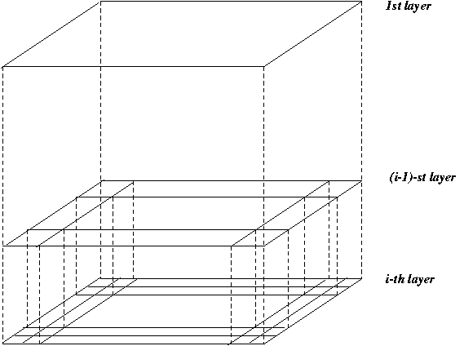
STING: A Statistical Information Grid Approach
Wang, Yang and Muntz (VLDB’97)
The spatial area area is divided into rectangular cells
There are several levels of cells corresponding to different levels of resolution

Slide 5
The STING Clustering Method
Each cell at a high level is partitioned into a number of smaller cells in the next lower level
Statistical info of each cell is calculated and stored beforehand and is used to answer queries
Parameters of higher level cells can be easily calculated from parameters of lower level cell
count, mean, s, min, max
type of distribution—normal, uniform, etc.
Use a top-down approach to answer spatial data queries
Start from a pre-selected layer—typically with a small number of cells
For each cell in the current level compute the confidence interval

Slide 6
Comments on STING
Remove the irrelevant cells from further consideration
When finish examining the current layer, proceed to the next lower level
Repeat this process until the bottom layer is reached
Advantages:
Query-independent, easy to parallelize, incremental update
O(K), where K is the number of grid cells at the lowest level
Disadvantages:
All the cluster boundaries are either horizontal or vertical, and no diagonal boundary is detected

Slide 7
WaveCluster: Clustering by Wavelet Analysis (1998)
Sheikholeslami, Chatterjee, and Zhang (VLDB’98)
A multi-resolution clustering approach which applies wavelet transform to the feature space
How to apply wavelet transform to find clusters
Summarizes the data by imposing a multidimensional grid structure onto data space
These multidimensional spatial data objects are represented in a n-dimensional feature space
Apply wavelet transform on feature space to find the dense regions in the feature space
Apply wavelet transform multiple times which result in clusters at different scales from fine to coarse

Slide 8
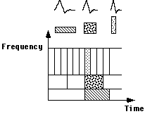
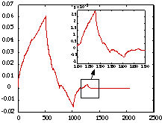
Wavelet Transform
Wavelet transform: A signal processing technique that decomposes a signal into different frequency sub-band (can be applied to n-dimensional signals)
Data are transformed to preserve relative distance between objects at different levels of resolution
Allows natural clusters to become more distinguishable

Slide 9
The WaveCluster Algorithm
Input parameters
# of grid cells for each dimension
the wavelet, and the # of applications of wavelet transform
Why is wavelet transformation useful for clustering?
Use hat-shape filters to emphasize region where points cluster, but simultaneously suppress weaker information in their boundary
Effective removal of outliers, multi-resolution, cost effective
Major features:
Complexity O(N)
Detect arbitrary shaped clusters at different scales
Not sensitive to noise, not sensitive to input order
Only applicable to low dimensional data
Both grid-based and density-based

Slide 10
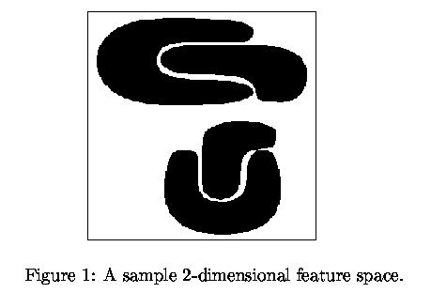
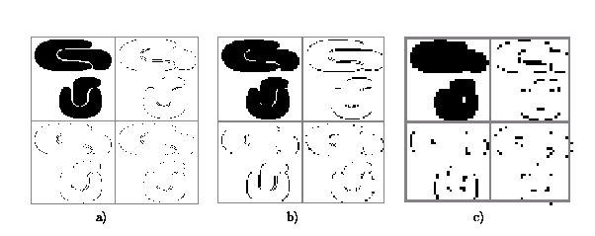
Quantization & Transformation
First, quantize data into m-D grid structure, then wavelet transform
a) scale 1: high resolution
b) scale 2: medium resolution
c) scale 3: low resolution

Slide 11
Model-Based Clustering
What is model-based clustering?
Attempt to optimize the fit between the given data and some mathematical model
Based on the assumption: Data are generated by a mixture of underlying probability distribution
Typical methods
Statistical approach
EM (Expectation maximization), AutoClass
Machine learning approach
COBWEB, CLASSIT
Neural network approach
SOM (Self-Organizing Feature Map)

Slide 12
EM — Expectation Maximization
EM — A popular iterative refinement algorithm
An extension to k-means
Assign each object to a cluster according to a weight (prob. distribution)
New means are computed based on weighted measures
General idea
Starts with an initial estimate of the parameter vector
Iteratively rescores the patterns against the mixture density produced by the parameter vector
The rescored patterns are used to update the parameter updates
Patterns belonging to the same cluster, if they are placed by their scores in a particular component
Algorithm converges fast but may not be in global optima

Slide 13


The EM (Expectation Maximization) Algorithm
Initially, randomly assign k cluster centers
Iteratively refine the clusters based on two steps
Expectation step: assign each data point X_{i} to cluster C_{i} with the following probability
Maximization step:
Estimation of model parameters

Slide 14
Conceptual Clustering
Conceptual clustering
A form of clustering in machine learning
Produces a classification scheme for a set of unlabeled objects
Finds characteristic description for each concept (class)
COBWEB (Fisher’87)
A popular a simple method of incremental conceptual learning
Creates a hierarchical clustering in the form of a classification tree
Each node refers to a concept and contains a probabilistic description of that concept

Slide 15
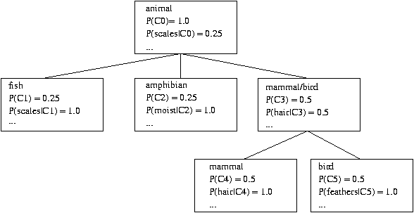
COBWEB Clustering Method
A classification tree

Slide 16
More on Conceptual Clustering
Limitations of COBWEB
The assumption that the attributes are independent of each other is often too strong because correlation may exist
Not suitable for clustering large database data – skewed tree and expensive probability distributions
CLASSIT
an extension of COBWEB for incremental clustering of continuous data
suffers similar problems as COBWEB
AutoClass (Cheeseman and Stutz, 1996)
Uses Bayesian statistical analysis to estimate the number of clusters
Popular in industry

Slide 17
Neural Network Approach
Neural network approaches
Represent each cluster as an exemplar, acting as a “prototype” of the cluster
New objects are distributed to the cluster whose exemplar is the most similar according to some distance measure
Typical methods
SOM (Soft-Organizing feature Map)
Competitive learning
Involves a hierarchical architecture of several units (neurons)
Neurons compete in a “winner-takes-all” fashion for the object currently being presented

Slide 18
Self-Organizing Feature Map (SOM)
SOMs, also called topological ordered maps, or Kohonen Self-Organizing Feature Map (KSOMs)
It maps all the points in a high-dimensional source space into a 2 to 3-d target space, s.t., the distance and proximity relationship (i.e., topology) are preserved as much as possible
Similar to k-means: cluster centers tend to lie in a low-dimensional manifold in the feature space
Clustering is performed by having several units competing for the current object
The unit whose weight vector is closest to the current object wins
The winner and its neighbors learn by having their weights adjusted
SOMs are believed to resemble processing that can occur in the brain
Useful for visualizing high-dimensional data in 2- or 3-D space

Slide 19
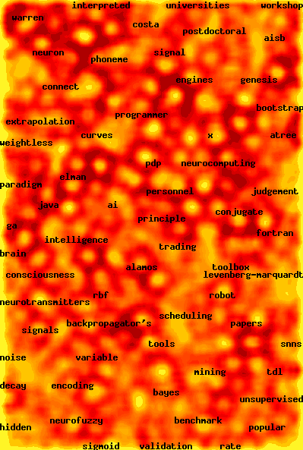
Web Document Clustering Using SOM
The result of SOM clustering of 12088 Web articles
The picture on the right: drilling down on the keyword “mining”
Based on websom.hut.fi Web page

Slide 20
What Is Outlier Discovery?
What are outliers?
The set of objects are considerably dissimilar from the remainder of the data
Example: Sports: Michael Jordon, Wayne Gretzky, ...
Problem: Define and find outliers in large data sets
Applications:
Credit card fraud detection
Telecom fraud detection
Customer segmentation
Medical analysis

Slide 21
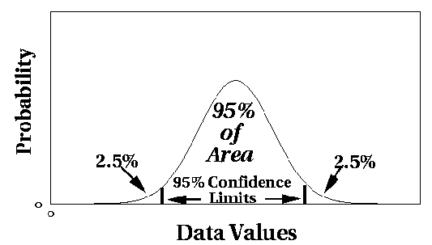
Outlier Discovery: Statistical Approaches
Assume a model underlying distribution that generates data set (e.g. normal distribution)
Use discordancy tests depending on
data distribution
distribution parameter (e.g., mean, variance)
number of expected outliers
Drawbacks
most tests are for single attribute
In many cases, data distribution may not be known

Slide 22
Outlier Discovery: Distance-Based Approach
Introduced to counter the main limitations imposed by statistical methods
We need multi-dimensional analysis without knowing data distribution
Distance-based outlier: A DB(p, D)-outlier is an object O in a dataset T such that at least a fraction p of the objects in T lies at a distance greater than D from O
Algorithms for mining distance-based outliers
Index-based algorithm
Nested-loop algorithm
Cell-based algorithm

Slide 23
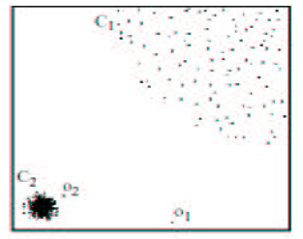
Density-Based Local Outlier Detection
Distance-based outlier detection is based on global distance distribution
It encounters difficulties to identify outliers if data is not uniformly distributed
Ex. C₁ contains 400 loosely distributed points, C₂ has 100 tightly condensed points, 2 outlier points o₁, o₂
Distance-based method cannot identify o₂ as an outlier
Need the concept of local outlier
Local outlier factor (LOF)
Assume outlier is not crisp
Each point has a LOF

Slide 24
Outlier Discovery: Deviation-Based Approach
Identifies outliers by examining the main characteristics of objects in a group
Objects that “deviate” from this description are considered outliers
Sequential exception technique
simulates the way in which humans can distinguish unusual objects from among a series of supposedly like objects
OLAP data cube technique
uses data cubes to identify regions of anomalies in large multidimensional data

Slide 25
Homework
Discuss the concept of outlier analysis.
Discuss Grid based clustering.

Slide 26
References
TEXT BOOKS
Introduction to Data Mining, Tan, Steinbach and Vipin Kumar, Pearson Education, 2016
REFERENCE BOOKS
Data Mining: Concepts and Techniques, Pei, Han and Kamber, Elsevier (2nd edition)
Journals
https://www.sciencedirect.com/science/article/pii/B9780323857086000084

Slide 27
Thank you
Please Send Your Queries on:
e-Mail: neha.e11231@cumail.in

